Slide 1


GitHub Page:
Will They Get the Job?
Tackling Imbalanced Data with Ensemble and Skew Kernel Methods
Donia Besher
Mathematics Student
Sorbonne Université
A00021999@sorbonne.ae
02/05/2025

Slide 2


Placement Puzzle: Crack the Hiring Code
01: Goal
Develop a machine learning model to predict whether a student will be placed based on their profiles.
02: Dataset
Features: Candidate attributes (e.g., Academic Performance, skills, experience).
Target Variable: Placement outcome ("Placed" or "Not Placed").
03: Evaluation Metric
Submissions are scored on: $F1 score=2×\frac{Precision × Recall}{Precision + Recall}$
04: Impact
Potential for real-world implementation in recruitment platforms to improve efficiency.

Slide 3
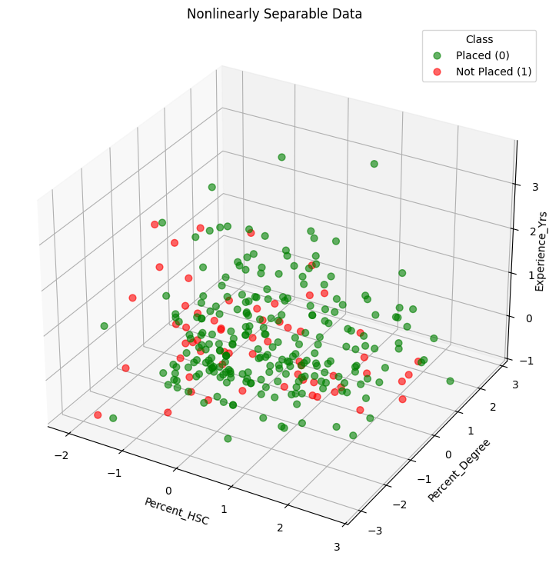
Challenges
Multicollinearity
Problematic Features based on VIF:
Specialization_MBA
Course_Degree
Stream_HSC
DOES NOT IMPACT TREE BASED MODELS!
Many Categorical Variables
Features: 11 numerical - 7 categorical
03
04
Missing Values
Small Sample Size
02
05
Entrance_Test
Only 300 observations
Train: 210 (70%)
Validation: 45 (15%)
Test: 45 (15%)
01
06
Imbalanced Data
Nonlinearly Separable
Imbalance Ratio: 5:1

Slide 4
Features Selected:
Gender
Percent_SSC
Percent_HSC
Percent_Degree
Experience_Yrs
1
GHOST
SMOTE
4
Median Imputation
Solutions
2
Feature Selection using LASSO
5
Kernalized SVM
MLP
Ensemble
3
Categorical:
One Hot Encoding
Numerical:
Standardization
Note: Feature selection was performed using LASSO, followed by multicollinearity checks and iterative model performance evaluation.

Slide 5
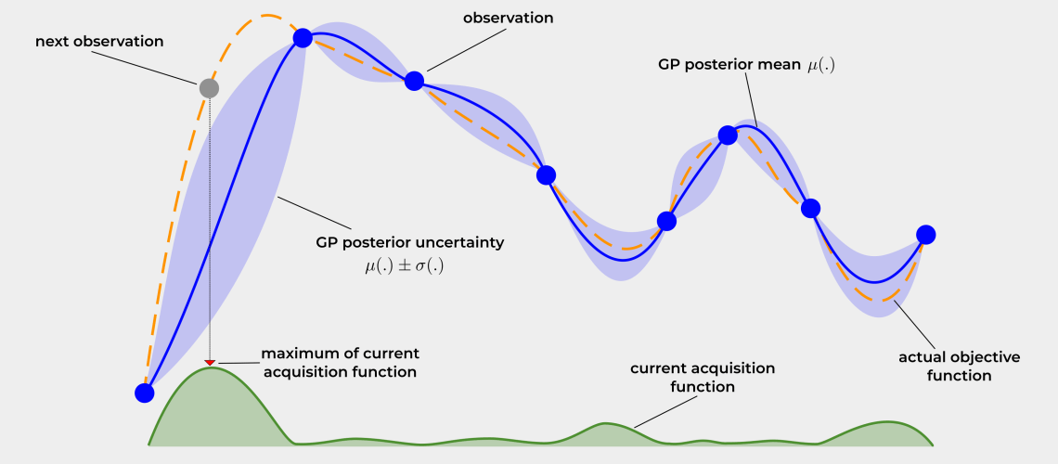
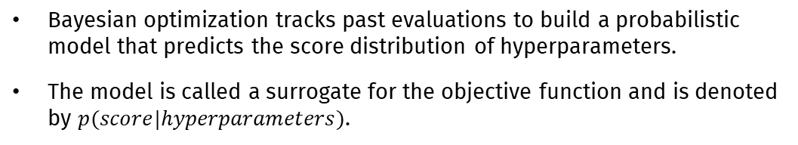
Hyperparameter Tuning with Bayesian Optimization
Motivation:
Grid and Random search are VERY slow and inefficient.
Random and grid search pay no attention to past results.
Main Idea:
Bayesian optimization tracks past evaluations to build a probabilistic model that predicts the score distribution of hyperparameters.
The model is called a surrogate for the objective function and is denoted by $p(score|hyperparameters)$.
Algorithm:
Build a surrogate probability model of the objective function.
Find the hyperparameters that perform best on the surrogate.
Apply these hyperparameters to the true objective function.
Update the surrogate model incorporating the new results.
Repeat steps 2–4 until max iterations or time is reached.
Figure Source: https://firasalhafez.com/2021/05/12/finding-the-optimal-learning-rate-using-bayesian-optimization/

Slide 6
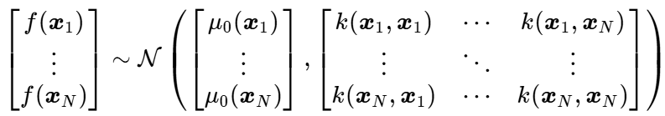
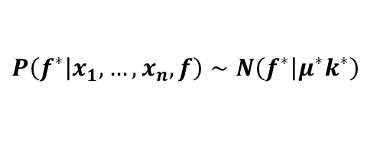
Hyperparameter Tuning with Bayesian Optimization
It is a sequential, model-based approach for finding the global optimum of expensive black-box functions. It combines:
Probabilistic Surrogate Model: Approximates the unknown objective function $f\left(x\right)$.
Gaussian Process: A function $f$ is a Gaussian Process (denoted $f ∼ GP(μ_{0},K)$), if any finite collection of evaluations $\{f\left(x_{1}\right),f\left(x_{2}\right), …,f\left(x_{N}\right)\}$ is normally distributed:
Gaussian Process Regression: A non-parametric Bayesian approach for inferring a distribution over the function of interest.
The posterior is given by:
$$P\left(\left.f^{∗}\right|x_{1},…, x_{n},f\right)∼N\left(\left.f^{∗}\right|μ^{∗}k^{∗}\right)$$
CONJUGATE PRIOR !!!

Slide 7
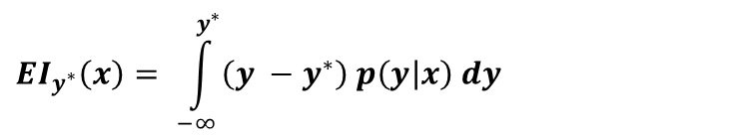
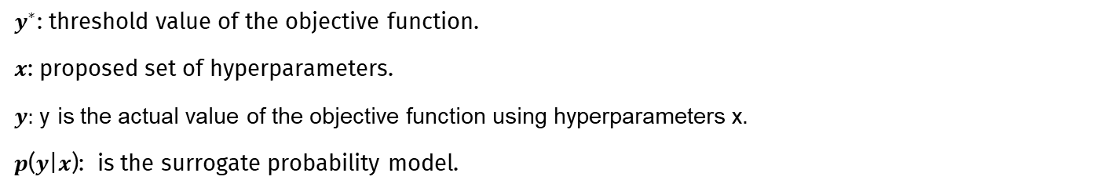
Hyperparameter Tuning with Bayesian Optimization
It is a sequential, model-based approach for finding the global optimum of expensive black-box functions. It combines:
Acquisition/Selection Function: The criteria by which the next set of hyperparameters are chosen from the surrogate function.
$${EI}_{y^{∗}}\left(x\right)= \int_{−∞}^{y^{∗}}{\left(y −y^{∗}\right) p\left(y | x\right) dy}$$
Expected Improvement:
$y^{∗}$: threshold value of the objective function.
$x$: proposed set of hyperparameters.
$y:$ y is the actual value of the objective function using hyperparameters x.
𝒑(𝒚|𝒙): is the surrogate probability model.
If the integral is positive, then the hyperparameters $x$ are expected to yield a better result than the best observed value of the objective function $y^{∗}$.

Slide 8
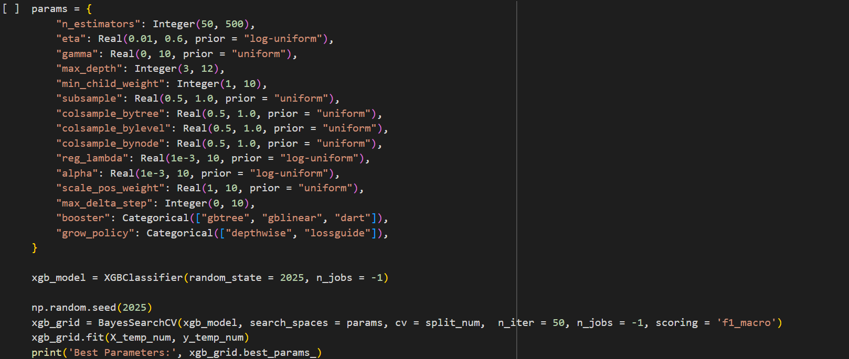
Hyperparameter Tuning with Bayesian Optimization

Slide 9

What Worked, What Didn’t
Classifier | SMOTE | GHOST | Imbalanced Treatment | Comments
KNN
Logistic
Decision Tree
Random Forest
Bagging
AdaBoost
Gradient Boosting
XGBoost
CATBoost
SVM
MLP
Surprisingly works well !
Private
Public
Extremely poor performance
Hillinger Distance
Performs best with full feature set
Class Weight: {0: 1, 1: 5}
GHOST improved the performance
SMOTE improved the performance
Performs best with LASSO features
SMOTE improved the performance
Private
Public
scale_pos_weight: 5
The best performing model
scale_pos_weight: 3.46
Extremely poor performance
Kernelized SVM
Second best performing model
Private
Public
SMOTE improved the performance

Slide 10






























Model 1: Ensemble with MLP
$${\hat{y}}_{XGB}$$
$${ X}_{{full}_{N}}$$
$${ X}_{{SD}_{N}}$$
$${ X}_{{num}_{N}}$$
$${ X}_{{SD}_{N}}$$
$$W^{\left(1\right)}$$
$${\hat{y}}_{SVM}$$
$$W^{\left(k\right)}$$
$$h_{1}^{\left(1\right)}$$
$$h_{1}^{\left(k\right)}$$
$${\hat{y}}_{XGB}$$
$$v$$
$${\hat{y}}_{KNN}$$
$${\hat{y}}_{KNN}$$
$$h_{2}^{\left(1\right)}$$
$$h_{2}^{\left(k\right)}$$
$${\hat{y}}_{ENSM}$$
$${ X}_{{full}_{2}}$$
$$X_{{SD}_{2}}$$
$${ X}_{{num}_{2}}$$
$$X_{{SD}_{2}}$$
$$X_{{SD}_{N}}$$
$${\hat{y}}_{SVM}$$
$$h_{m_{1}}^{\left(1\right)}$$
$$h_{m_{k}}^{\left(k\right)}$$
$${ X}_{{full}_{1}}$$
$$X_{{SD}_{1}}$$
$${ X}_{{num}_{1}}$$
$$X_{{SD}_{1}}$$
$$X_{{SD}_{1}}$$
Phase 1: Train KNN, SVM & XGBoost on standardized training data.
Phase 2: Train MLP on Phase 1 predictions and standardized training data.
Standardization
Bayesian Optimization
Weights
Full Features
Selected Numeric Features
Private
Public

Slide 11
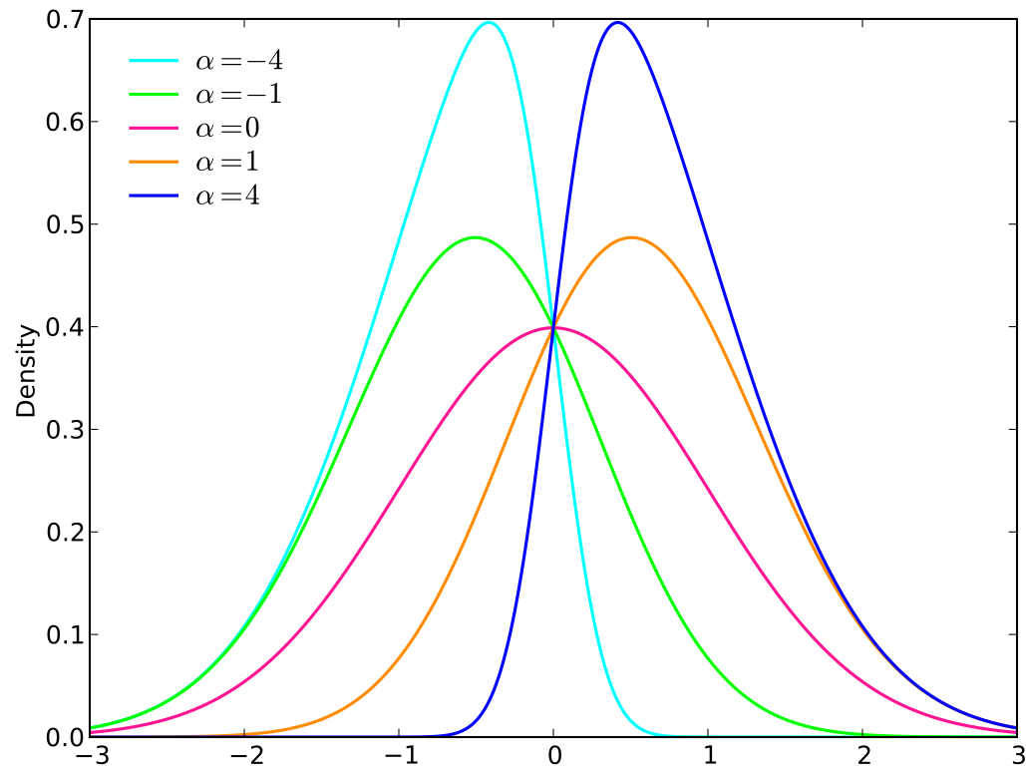

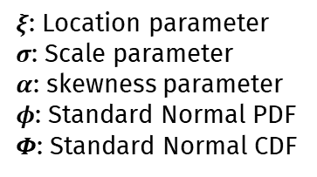

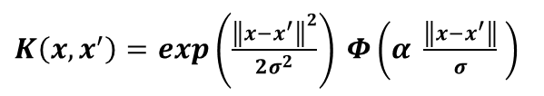
Model 2: Skew SVM
Dual Optimization Problem?
Skew Kernel
$K\left(x,x^{′}\right)=exp\left(\frac{{\left\|x−x^{′}\right\|}^{2}}{2σ^{2}}\right) Φ\left(α \frac{\left\|x−x^{′}\right\|}{σ} \right)$
Figure source: https://en.wikipedia.org/wiki/Skew_normal_distribution
$α>0:$ heavier right tail
$α<0:$ heavier left tail
Idea:
Motivation
Skew-Normal Distribution:
$ξ$: Location parameter
$σ$: Scale parameter
$α$: skewness parameter
$φ$: Standard Normal PDF
𝜱: Standard Normal CDF
$f\left(x,α,ξ,σ\right)= \frac{2}{σ} φ\left( \frac{x−ξ}{2} \right) Φ\left(α \frac{x−ξ}{2σ} \right)$
Polynomial and RBF kernels assume symmetric data distributions.

Slide 12
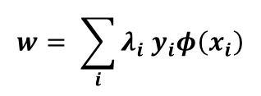
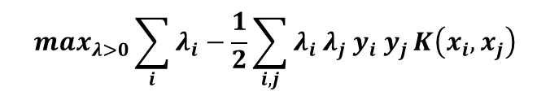
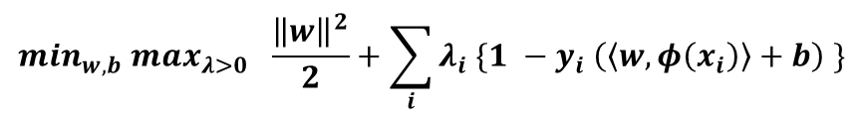

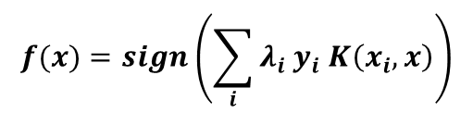
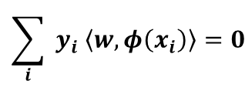
Model 2: Skew SVM
$$\min_{w,b}\frac{{\left\|w\right\|}^{2}}{2} subject to y_{i}\left(\left\langle w,φ\left(x_{i}\right)\right\rangle +b\right) ≥1 ∀i$$
Prime Optimization Problem:
$${\min_{w,b} max}_{λ>0 } \frac{{\left\|w\right\|}^{2}}{2}+\sum_{i}{λ_{i} \{1 −y_{i} \left(\left\langle w,φ\left(x_{i}\right)\right\rangle +b\right)} \}$$
Constrained Optimization:
$$w= \sum_{i}{λ_{i} y_{i}φ\left(x_{i}\right)}$$
$$\sum_{i}{ y_{i} \left\langle w,φ\left(x_{i}\right)\right\rangle =0}$$
Partial Derivatives:
$$\max_{λ>0}\sum_{i}{λ_{i}}−\frac{1}{2}\sum_{i,j}{λ_{i} λ_{j} y_{i} y_{j}}K\left(x_{i},x_{j}\right)$$
Dual Optimization Problem:
$$f(x)=sign\left(\sum_{ⅈ}{λ_{i}{ y}_{i} K\left(x_{i},x\right)}\right)$$
Decision function:
Private
Public

Slide 13
References
Wu, J., Chen, X. Y., Zhang, H., Xiong, L. D., Lei, H., & Deng, S. H. (2019). Hyperparameter optimization for machine learning models based on Bayesian optimization. Journal of Electronic Science and Technology, 17(1), 26-40.
Feurer, M., & Hutter, F. (2019). Hyperparameter optimization (pp. 3-33). Springer International Publishing.
https://www.miguelgondu.com/blogposts/2023-07-31/intro-to-bo/
https://medium.com/data-science/a-conceptual-explanation-of-bayesian-model-based-hyperparameter-optimization-for-machine-learning-b8172278050f
Esposito, C., Landrum, G. A., Schneider, N., Stiefl, N., & Riniker, S. (2021). GHOST: adjusting the decision threshold to handle imbalanced data in machine learning. Journal of Chemical Information and Modeling, 61(6), 2623-2640.
Naik, S. M., Chakraborty, T., Panja, M., Hadid, A., & Chakraborty, B. (2025). Skew-probabilistic neural networks for learning from imbalanced data. Pattern Recognition, 111677.
http://azzalini.stat.unipd.it/SN/Intro/intro.html
All implementation details and source code are available on my GitHub page.

